Slide 1
Data Mining
Week4 Lecture 2 Part2
Bias and Variance
By Eesha Tur Razia Babar

Slide 2
Bias
Bias is the amount that a model’s prediction differs from the target value, compared to the training data. Bias error results from simplifying the assumptions used in a model so the target functions are easier to approximate.
Bias creates consistent errors in the ML model, which represents a simpler ML model that is not suitable for a specific requirement

Slide 3
Bias
When the Bias is high, assumptions made by our model are too basic, and the model can’t capture the important features of our data. This means that our model hasn’t captured patterns in the training data and hence cannot perform well on the testing data too. If this is the case, our model cannot perform on new data
This instance, where the model cannot find patterns in our training set and hence fails for both seen and unseen data, is called Underfitting.

Slide 4
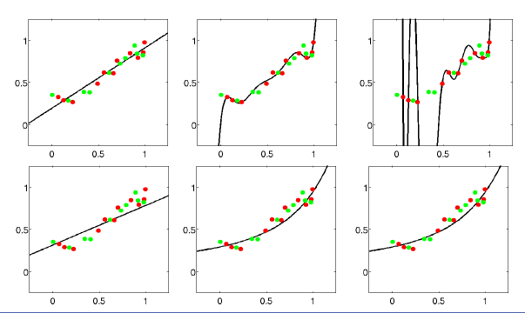
Example

Slide 5
Variance
Variance is the very opposite of Bias. During training, it allows our model to ‘see’ the data a certain number of times to find patterns in it. If it does not work on the data for long enough, it will not find patterns and bias occurs. On the other hand, if our model is allowed to view the data too many times, it will learn very well for only that data. It will capture most patterns in the data, but it will also learn from the unnecessary data present, or from the noise.

Slide 6
Variance
Model with high variance pays a lot of attention to training data and does not generalize on the data which it hasn’t seen before. As a result, such models perform very well on training data but has high error rates on test data.

Slide 7
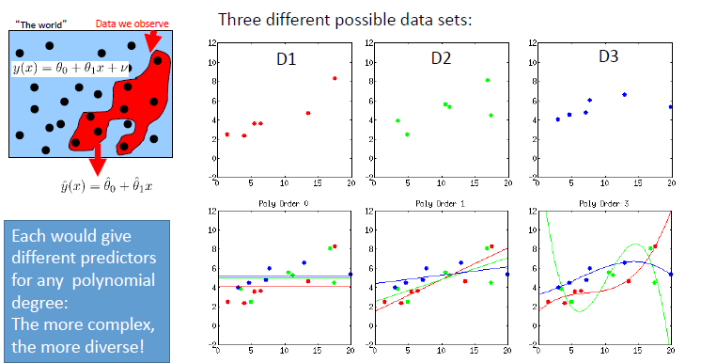
Example

